Slide 1

SUPPORT SLIDES

Slide 2




  Key Points on Discussing HIV Cure Research with Patients
Current scientific validity
  There is currently no widely available cure for HIV
  Most HIV cure-related studies are designed to advance scientific knowledge rather than provide direct clinical benefits
Patients should receive balanced, accurate, and understandable information about HIV cure-related research to make informed decisions that align with their values and goals
Explain HIV cure-related research in understandable language
  Calibrate expectations about HIV cure-related research outcomes
  Clarify terms such as “ART-free durable control”, ATIs
Discuss potential benefits and risks
  Possible benefits: contributing to scientific progress, access to additional monitoring, helping future generations
  Potential risks: experimental intervention risks, ATI-related risks, psychosocial effects
Address ATIs – not all HIV cure-related trials need ATIs
  Explain that some studies require temporary stopping of ART under close monitoring
  Discuss possible viral rebound, HIV transmission considerations, symptoms, and monitoring procedures
Support Informed and voluntary decision-making
  Encourage questions and discussion with family, partners, or trusted individuals if desired
  Emphasize that participation is voluntary and that declining participation will not affect clinical care
Notes:
Panel support slide: “Key Points on Discussing HIV Cure Research with Patients” (refer to if needed)

Slide 3



  Role of Clinicians
Promote Participant Safety
Inform Patients
  throughout the research process
about HIV cure-related research opportunities
  Stay Informed about Patient Participation
  Support Informed Decision-Making
  (e.g., ATIs)
  with balanced information about potential benefits and risks
  Help Build Trust in Research
  through open communication and patient-centered care
  Identify and Refer Interested Patients
  to appropriate studies
Providers are essential partners in HIV cure research by informing patients, supporting informed choices, facilitating referrals, and helping safeguard participant well-being
Notes:
Panel support slide: “Role of Clinicians” (refer to if needed)

Slide 4
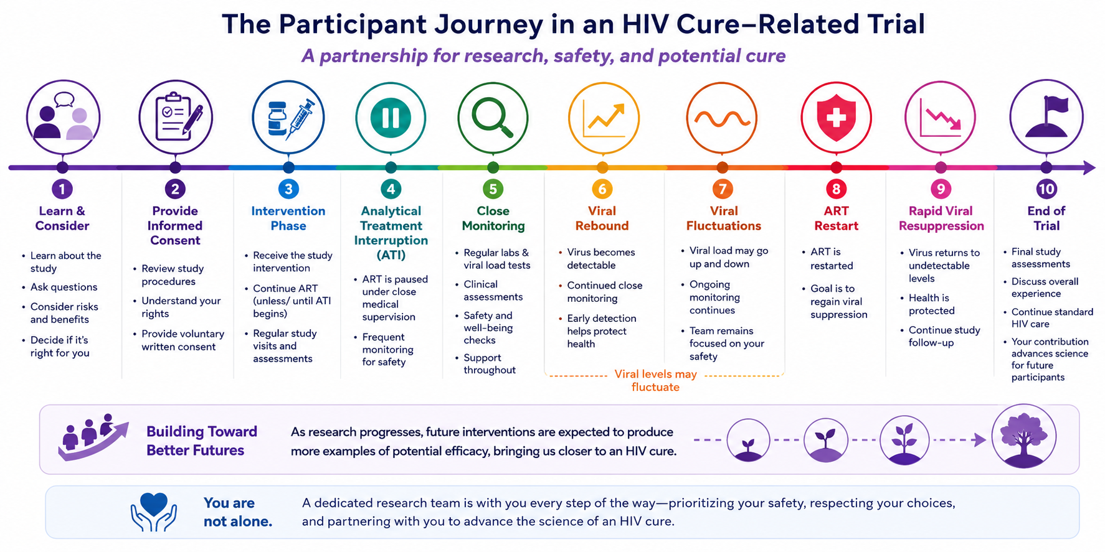
Notes:
Panel support slide: “The Participant Journey” (refer to if needed)

Slide 5



Additional Resources
Recommendations from the 2nd Consensus Workshop on Analytical Treatment Interruption in HIV Research Trials.
Ndung'u T, Dong KL, Colby DJ, Deeks SG, Cotton MF, Dubé K, Goulder PJ, Julg B, Nsubuga M, Ajibola G, Bar KJ, Bengu N, Bwakura-Dangarembizi M, Caskey M, Cromhout G, Kekitiinwa AR, Kilembe W, Kuhn L, Likhitwonnawut U, Mgodi NM, Persaud D, Peluso MJ, Rasmussen TA, Romo M, Sacdalan C, Samaneka W, Shapiro R, Søgaard OS, Tudor-Williams G, Wambui C, Tressler R, Lewin SR, Crowell TA, Kasprowicz VO, Trautmann L; 2nd ATI Consensus Workshop. Lancet HIV 2026; Apr 13(4): e271 – 281.
BEAT-HIV Delaney Collaboratory. Joining Forces to Advance HIV Cure Research. 2020.
Available at:
https://www.beat-hiv.org/wp-content/uploads/2023/05/BEAT-HIV-Position-Paper.pdf

